Slide 1
Arduino Drone
Team 0xDEADBEEF
Ryan Berge and Jeremy DeHaan

Slide 2
Arduino Drone fan
Team 0xDEADBEEF
Ryan Berge and Jeremy DeHaan

Slide 3

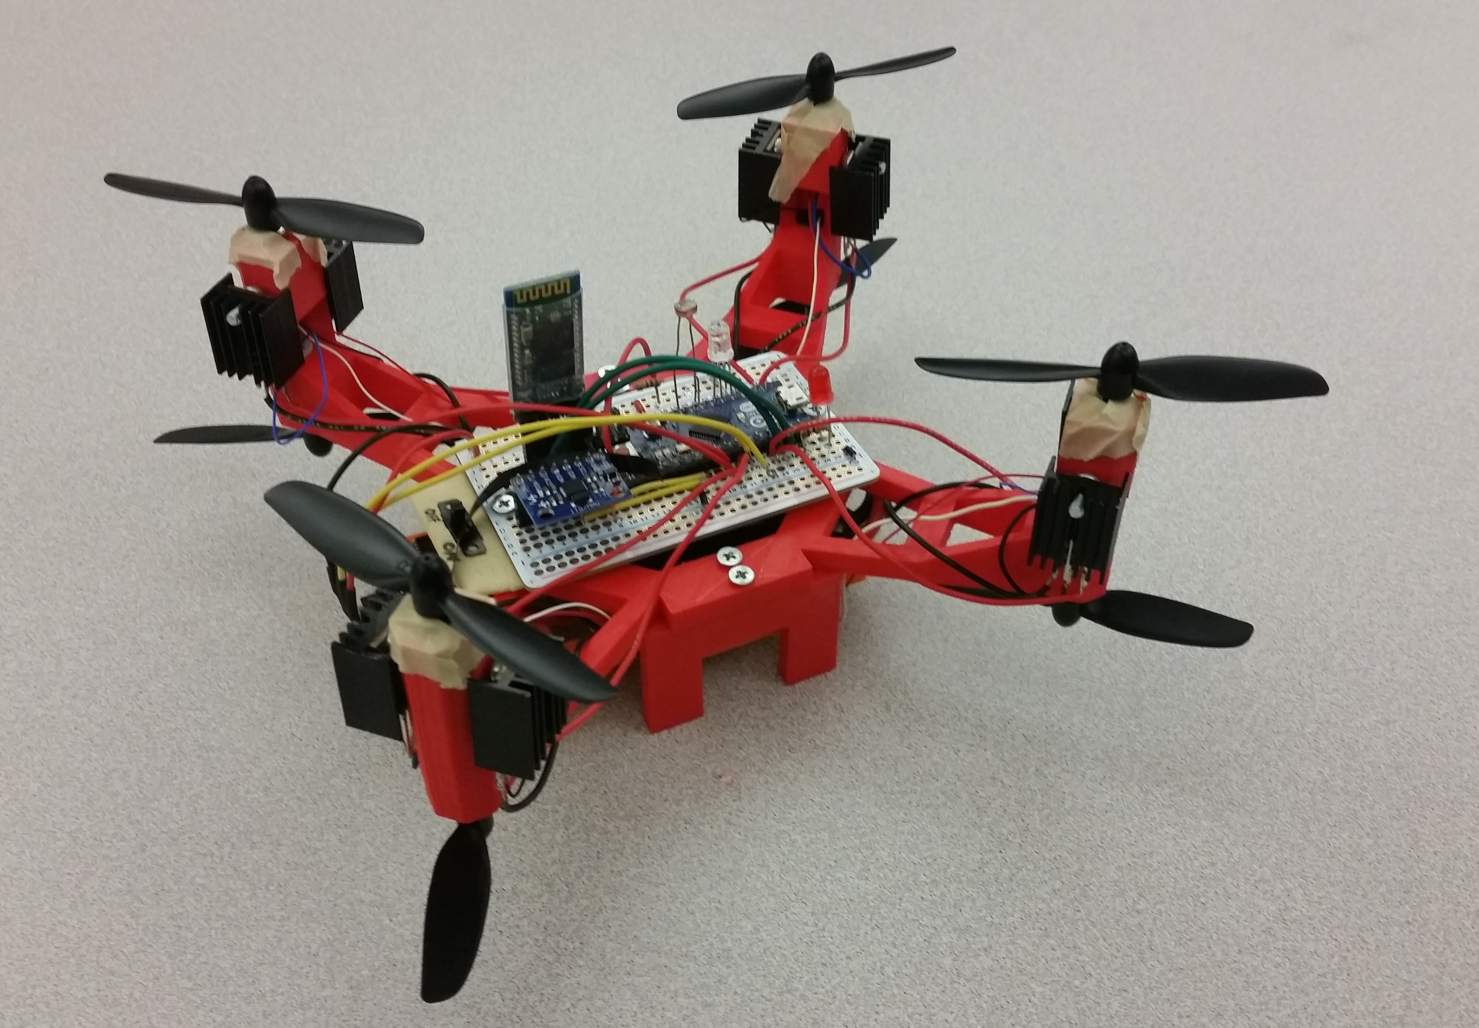
Project Goals
Drone
fan

Slide 4
Project Goals
fan
Create a Quad-Copter Arduino Remote-Controlled Drone
Wireless Bluetooth Communication for Control Pad
Automatic Take-Off and Landing Procedures
Automatic Stabilization
Music
Low-Light Detection

Slide 5
Original Part List
3-Axis Analog Gyro
4 USAQ 8520 Coreless Brushed Motors
LiPo Battery 350mAh
LiPo Battery Charger
1 XT60 Power Distribution Board
Half-sized Breadboard PCB
2 Qunqi L298N Motor Drive Controllers
2 HC-05 Bluetooth Transmitter/Receiver
Buzzer
Various LED lights
8 Buttons
Ultrasonic Sensor
Photocell Sensor
3D-Printed Chassis
2 Arduino Mega Boards
SPDC Slide Switch
2 USB Cables

Slide 6
Final Part List
3-Axis Analog Gyro
4 USAQ 8520 Coreless Brushed Motors
12 USAQ 8520 Coreless Brushed Motors
LiPo Battery 350mAh
LiPo Battery 850mAh
LiPo Battery Charger
1 XT60 Power Distribution Board
2 XT60 Power Distribution Boards?
Half-sized Breadboard PCB
2 Qunqi L298N Motor Drive Controllers
2 HC-05 Bluetooth Transmitter/Receiver
Buzzer
Various LED lights
8 Buttons
Ultrasonic Sensor
Photocell Sensor
3D Printed Chassis
Several 3D Printed Chassis
2 Arduino Mega Boards
1 Mega, 1 Micro
SPDC Slide Switch
2 USB Cables

Slide 7
Final Part List
3-Axis Analog Gyro
4 USAQ 8520 Coreless Brushed Motors
12 USAQ 8520 Coreless Brushed Motors
LiPo Battery 350mAh
LiPo Battery 850mAh
LiPo Battery Charger
1 XT60 Power Distribution Board
2 XT60 Power Distribution Boards?
Half-sized Breadboard PCB
2 Qunqi L298N Motor Drive Controllers
2 HC-05 Bluetooth Transmitter/Receiver
Buzzer
Various LED lights
8 Buttons
Ultrasonic Sensor
Photocell Sensor
3D Printed Chassis
Several 3D Printed Chassis
2 Arduino Mega Boards
1 Mega, 1 Micro
SPDC Slide Switch
2 USB Cables
Balloons

Slide 8
Final Product
Original Goals:
Create a Quad-Copter Arduino Remote-Controlled Drone
Wireless Bluetooth Communication for Control Pad
Automatic Take-Off and Landing Procedures
Automatic Stabilization
Music
Low-Light Detection

Slide 9

Final Product
Original Goals:
Create a Quad-Copter Arduino Remote-Controlled Drone
Wireless Bluetooth Communication for Control Pad
Automatic Take-Off and Landing Procedures
Automatic Stabilization
Music
Low-Light Detection

Slide 10
Final Product
Original Goals:
Create a Quad-Copter Arduino Remote-Controlled Drone
Wireless Bluetooth Communication for Control Pad
Automatic Take-Off and Landing Procedures
Automatic Stabilization
Music
Low-Light Detection

Slide 11
Final Product
Original Goals:
Create a Quad-Copter Arduino Remote-Controlled Drone
Wireless Bluetooth Communication for Control Pad
Automatic Take-Off and Landing Procedures
Automatic Stabilization
Music
Low-Light Detection

Slide 12
Final Product
Original Goals:
Create a Quad-Copter Arduino Remote-Controlled Drone
Wireless Bluetooth Communication for Control Pad
Automatic Take-Off and Landing Procedures
Automatic Stabilization
Music
Low-Light Detection

Slide 13
Final Product
Original Goals:
Create a Quad-Copter Arduino Remote-Controlled Drone
Wireless Bluetooth Communication for Control Pad
Automatic Take-Off and Landing Procedures
Automatic Stabilization
Music
Low-Light Detection

Slide 14
Final Product
Original Goals:
Create a Quad-Copter Arduino Remote-Controlled Drone
Wireless Bluetooth Communication for Control Pad
Automatic Take-Off and Landing Procedures
Automatic Stabilization
Music
Low-Light Detection

Slide 15
Final Product
Original Goals:
Create a Quad-Copter Arduino Remote-Controlled Drone
Wireless Bluetooth Communication for Control Pad
Automatic Take-Off and Landing Procedures
Automatic Stabilization
Music
Low-Light Detection
Drone Actually Flies

Slide 16

Final Product
Original Goals:
Create a Quad-Copter Arduino Remote-Controlled Drone
Wireless Bluetooth Communication for Control Pad
Automatic Take-Off and Landing Procedures
Automatic Stabilization
Music
Low-Light Detection
Drone Actually Flies

Slide 17
Problem?

Slide 18
Problem?
Drone is too heavy.

Slide 19
Problems Along The Way
Bluetooth HC-06 would not enter AT-Command Mode
3D-Printers warped drone parts
3D-Printers overheated and stopped halfway through
3D-Printers were unavailable
Motor Controllers don’t accept enough voltage
Ran out of female-to-female jumper cables
Bellevue store had only two 1.6mm screws
Motor Controllers overheating?

Slide 20
Problems Along The Way (continued)
Motor Controllers are too heavy
Burned out the battery

